Slide 1


WELCOME COURSE
GUIDELINES
Welcome to the immersive Lancôme induction program.
The Lancôme welcome course course has been developed to equip Trainers with the resources they need to effectively convey the brand and category philosophy to our new Beauty Advisors, ensuring they are well-prepared for their journey with Lancôme.

Slide 2

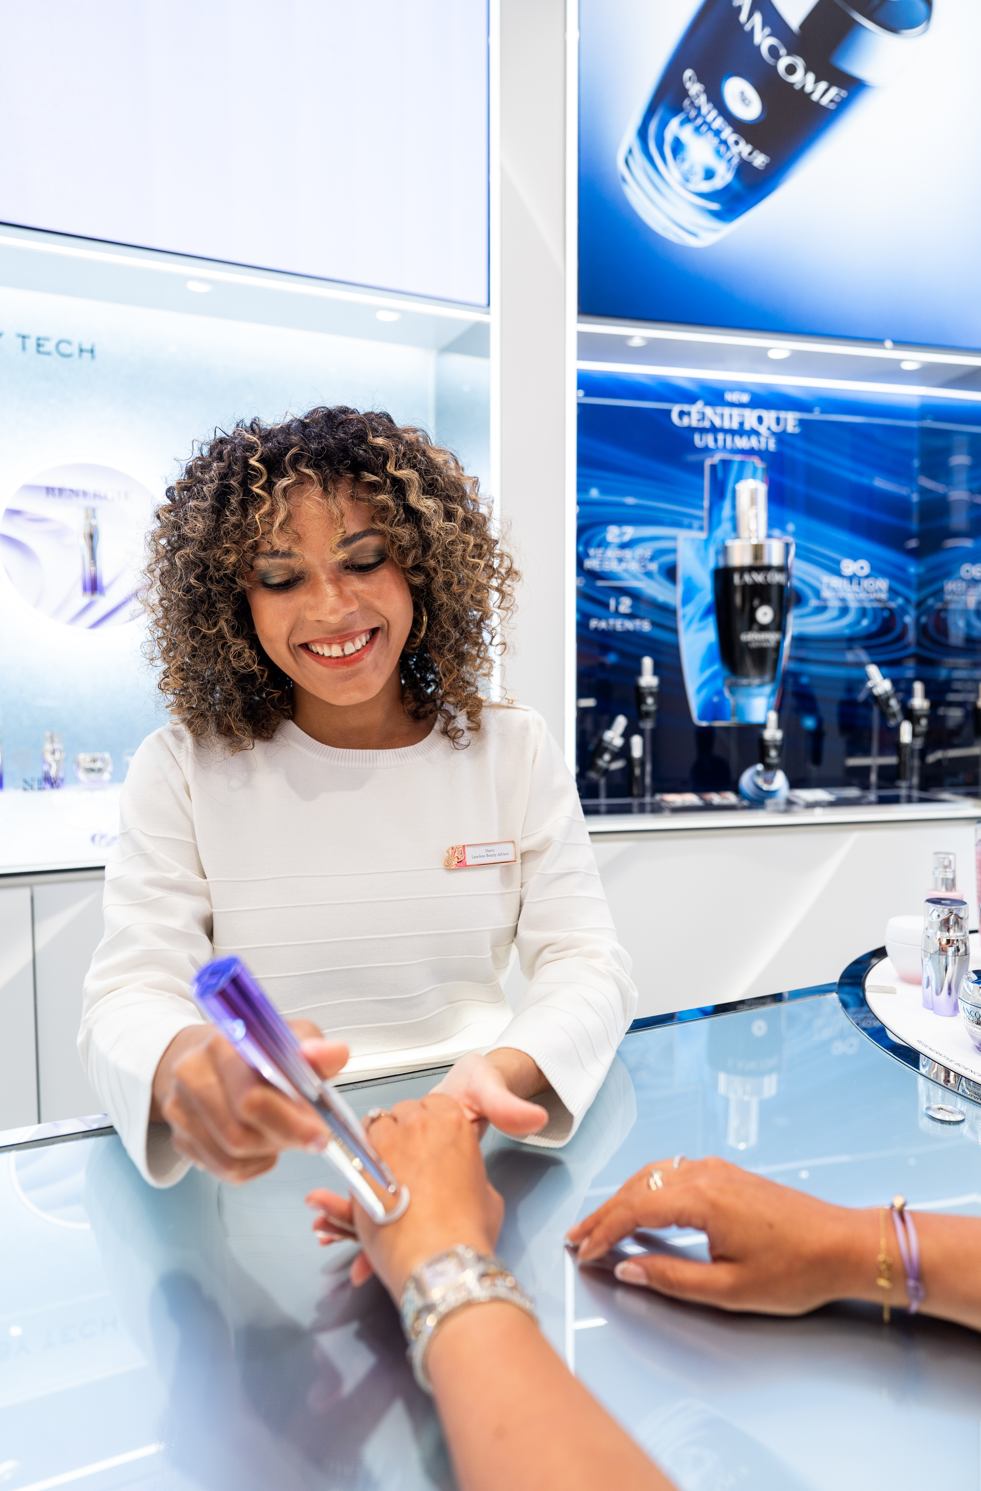
Welcome Course Objectives
1-Brand Culture
Discover Lancôme's values and history for an authentic brand representation.
2- Product Expertise
Master in-depth knowledge of Lancôme franchises and products.
3-Sales Techniques
Acquire effective sales methods.
4- Excellent Customer Service
Develop skills to provide a memorable customer experience.
.

Slide 3
WELCOME COURSE ONBOARDING
BRAND, MASTERY OF THE COMPLETE CORE CATALOG AND SERVICES
DAY 1
DAY 2
DAY 3
DAY 4
DAY 5
FLAGSHIP LANCÔME
BEAUTY ADVISORS
Welcome & Fragrance
Skincare
Absolue
Premium
Makeup
Services
BRAND, MASTERY OF THE CORE CATALOG AND SALES
DAY 1
DAY 2
DAY 3
DEPARTMENT STORE
LANCÔME
BEAUTY ADVISORS
Welcome & Fragrance
Skincare
Makeup & sales
BRAND, MASTERY OF PILLARS
DAY 1
DAY 2
DAY 3
PERFUMERY
BEAUTY ADVISORS
Skincare pillars
Makeup pillars
Fragrance pillars

Slide 4
FLAGSHIPS LANCÔME BEAUTY ADVISORS

Slide 5
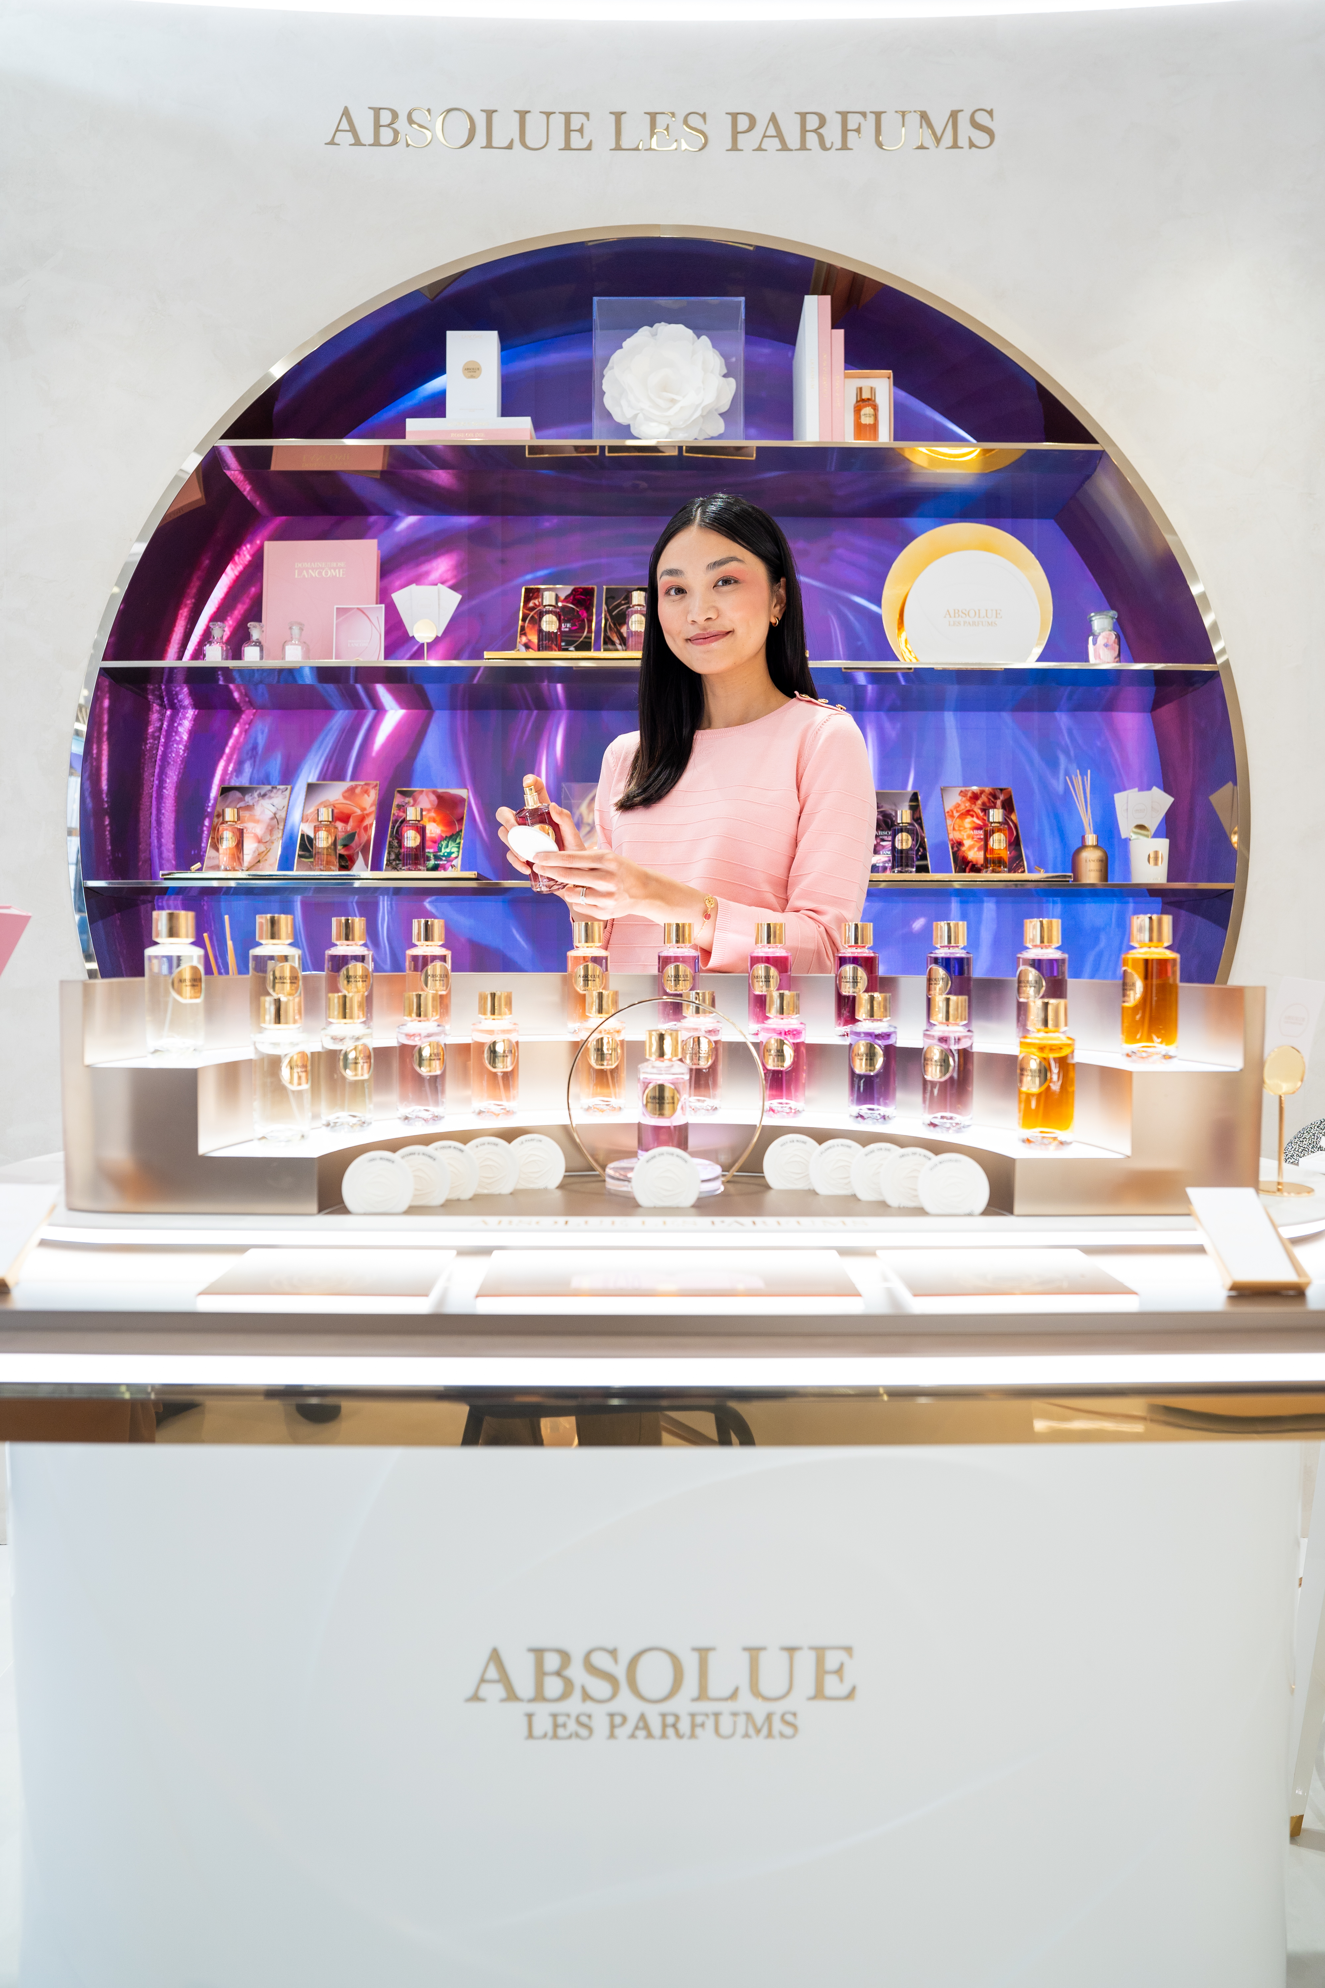
FLAGSHIPS LANCÔME BEAUTY ADVISORS
DAYS 1 & 2
1
Day 1: Brand introduction & Fragrances
BAs welcoming
Lancôme brand presentation
Presentation of Fragrance philosophy, ranges, products with olfactory exercises and role-playing
2
Day 2: Skincare
In-depth exploration of skincare philosophy, franchises and products, as well as skin diagnostic techniques and hands-on product application workshops

Slide 6
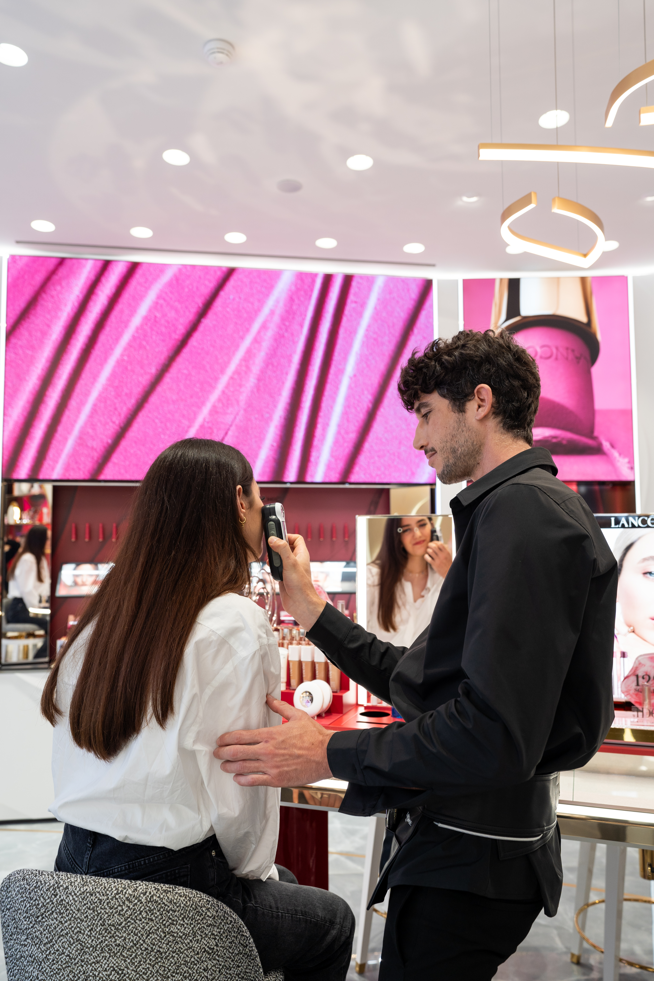
FLAGSHIPS LANCÔME BEAUTY ADVISORS DAYS 3 & 4
3
DAY 3 : Absolue Premium
Discovery of the Absolue premium philosophy, range and products
Personalized customer journey and high-end sales techniques
4
DAY 4 : Makeup
Presentation of Makeup philosophy, range, products
Deep dive into Makeup techniques
Personalized artistry tips

Slide 7
FLAGSHIPS LANCÔME BEAUTY ADVISORS
DAY 5
1
Sales Excellence
Discover 3-axis sales method with role-playing and situational exercises
2
Lancôme Services
Deep dive into Lancôme menu services
3
Customer journey
Discover the customer journey for a memorable experience
Loyalty techniques
4
Discover how to build lasting relationships with customers

Slide 8
DEPARTMENT STORES LANCÔME BEAUTY ADVISORS

Slide 9
Department Stores Lancôme Beauty Advisors
1
DAY 1
BAs welcoming
Lancôme brand presentation
Presentation of Fragrance philosophy, ranges, products with olfactory exercises and role-playing
2
DAY 2
In-depth exploration of skincare philosophy, franchises and products, included Absolue Premium range as well as skin diagnostic techniques and hands-on product application workshops.
3
DAY 3
Presentation of Makeup philosophy, range, products sales
Sales techniques, services, customer journey, building loyalty in a condensed merge of days 4 and 5 of the Flagship program.

Slide 10
PERFUMERY SESSION FOR MULTI-BRAND
BEAUTY ADVISORS

Slide 11
Perfumery Session for Multi-Brand
Beauty Advisors
1
Brand
Lancôme brand introduction
Skincare pillars
2
Presentation of skincare pillars and key skincare rou<tines, with powerful sales arguments.
Makeup pillars
3
Presentation makeup iconic products, with emphasis on their specificities against the competition.
Fragrances pillars
4
Presentation of our iconic perfumes, with effective sales tips.

Slide 12
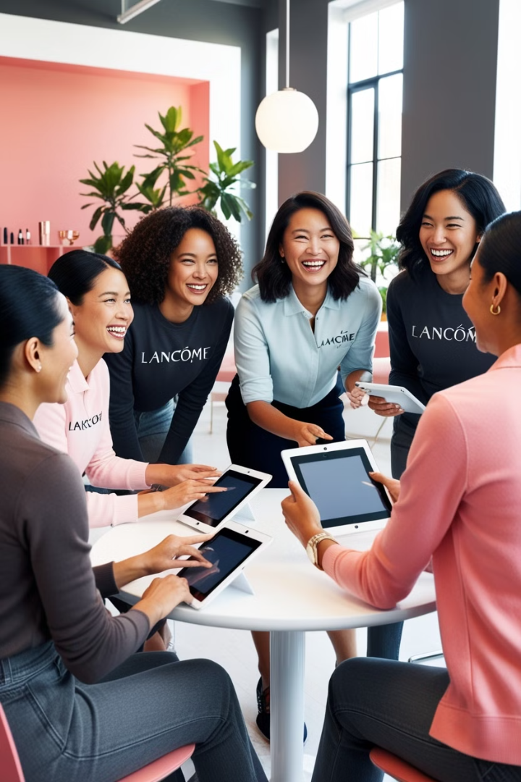
TRAINING METHODOLOGY
1
Interactivity
2
Ongoing assessment
Each day includes opportunities for discussion and Q&A to encourage active learning.
Regular assessments are integrated to validate the learning of participants.
3
Pédagogical Supports
4
Adaptation
Provision of presentations, product sheets and videos to reinforce learning.
The content and teaching methods are adapted according to the participants' level of experience.

Slide 13
LEARNING TRACK

Slide 14

SKINCARE LEARNING TRACKS
TITLE
SKILLS
DMI TRAINING & SEMINARS
TRAINING TOOLS
TIMING
  Advocay
  Organiaze & facilitate POS SC master Class, Open lab Event, Training
  Skin Science Territory & Product
  Deep Product knowledge
  Excellence in POS Sevvice Skincare & Premium
  Excellence in Cabin Treatment
Skincare Experts BAs target 10% to 20 % BAs depending the Zone.
National Skincare Expert Seminar & Skincare Trainers - trained by DMI &/year
Skin tch Academy TTT Skincare Expert Seminar (Digital our Physical Reginal
Q&A capusles SkincareTrainers 2x/year for Key innovation product or tech
Cabin & Semi cabin Absolue protocol Training
Advocay : NSE Guidelines 2022 + NSE NMA Guidelines 2023 + Tik Tok trends skincare 2024
3 DAYS NSE
SKINCARE
EXPERTS
SKINCARE TRAINERS
&
NATIONAL SKINCARE EXPERS ( NSE)
Absolue Premium Customer path POS services ( hand Youth 10’- face Cryo Sculptor 15’ + Face Petal sculptor 15’)
Absoolue Longevitty Premium Cabin protocols
TTT Seminare Content
2 DAYS SINCARE SERVICE SIGNATURE
4 DAYS CABIN
+
+
LANCÔME
BEAUTY
ADVISORS
&
LLUX BAS
Brand , Product knowledge & demo services
Skin knowledge physiologiy & Science Territories
Skin diagnosis, BT diagnosis Skin screen, Youth Finder, E YF
Texture sensoriality Storytelling
  Application Gestures Demi-Demo® Skincare
  Tech Service Experiences : 3 step PRB skincare Signaure Skin tech protocol
Beauty Tech : SkinScreen Essentials
Beauty Tech: Youth Finder
Beauty Tech : E –Skin Expert
Beauty Tech: Connect & Target
DMI Product, customer path & tech trainings ofr all Products
3 DAYS NSE
LOCAL
3 DAYS NSE
DMI Welcome Course – Skincare & Premium
SKINCARE SIGNATURE SERVICE SEMINAR
PRB GNF Signature service : 3 steps Signature Servcice
3 DAYS NSE
Uncovering Needs *; iBeauty (Asia) *
Lancôme Skincare & Client Path *
Absolue Client Path *
Demonstration & Link/Cross-Selling *
2-Minute Come Glam With Us™ Services *
Pro Radiance Booster Services *
Sampling & Follow-Up *
Youth Finder Service*
Advanced &
Skincare Expert
LOCAL O+O Trainings
Based on DMI product & Tech trainings
Application Gesture at home for demi-demo
Texture Sensoriality guide
+
+
ALL
BEAUTY
ADVISORS
Brand values and Iconic Products
Product 3 star : introduce, demo & reveal
Skin knowledge physiology
Lancôme Skincare Client Path Active listening skills, skin diagnosis, E skin Expert Beuaty tech
Recommendations, sampling
LOCAL
DMI Welcome Course - Skincare
BA Product Sheets
E Welcome course – Skincare
2 min Icones - Skincare
BT E-Skin Expert
Tutorial video how to
2 min Icones - Skincare
3 star product Training & BA sheet, videos demo

Slide 15
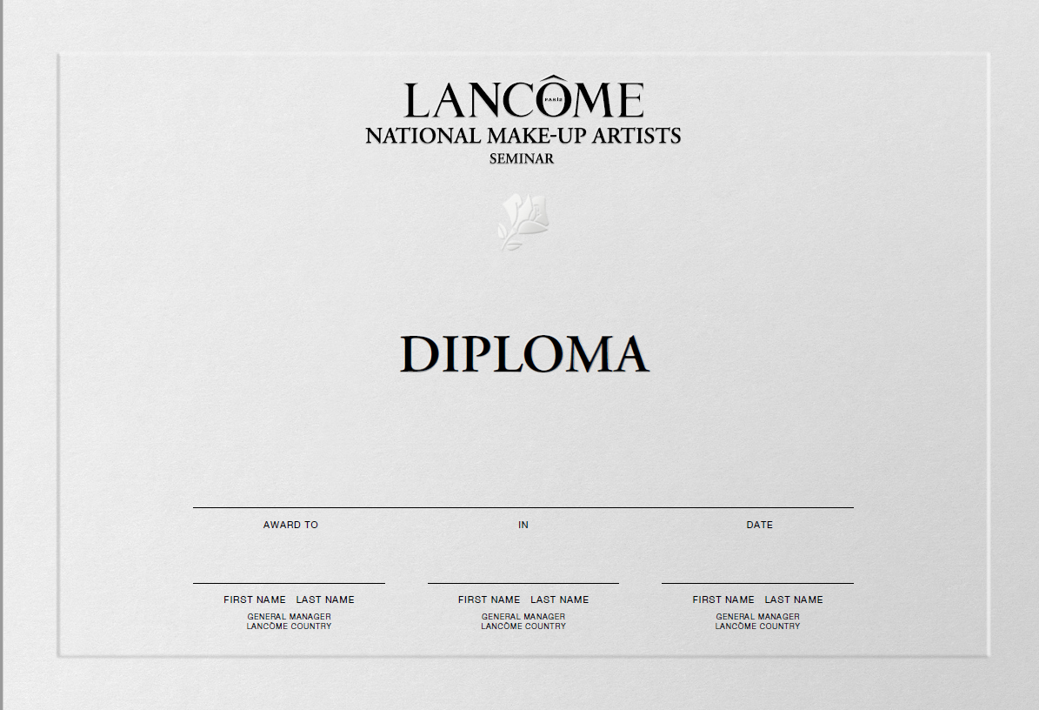
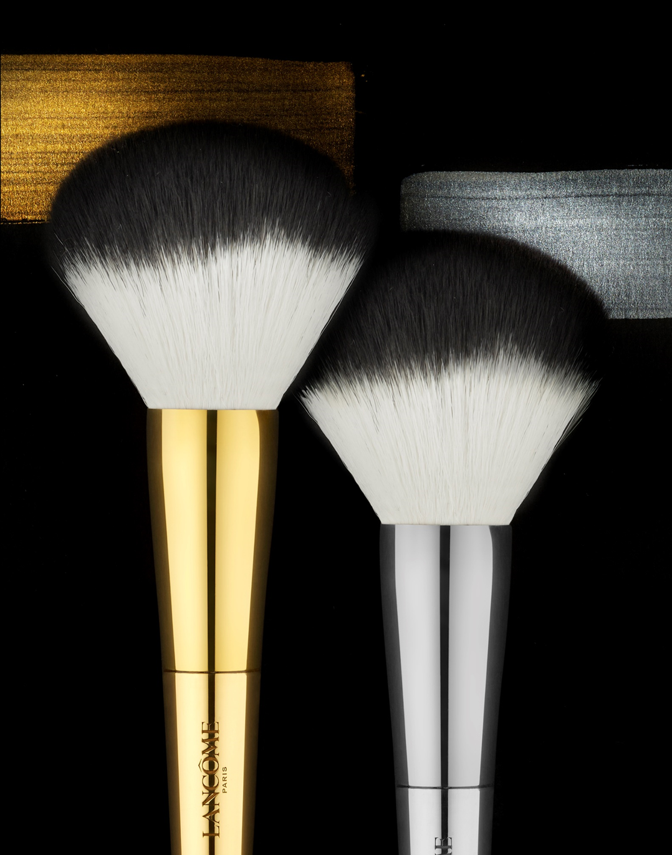
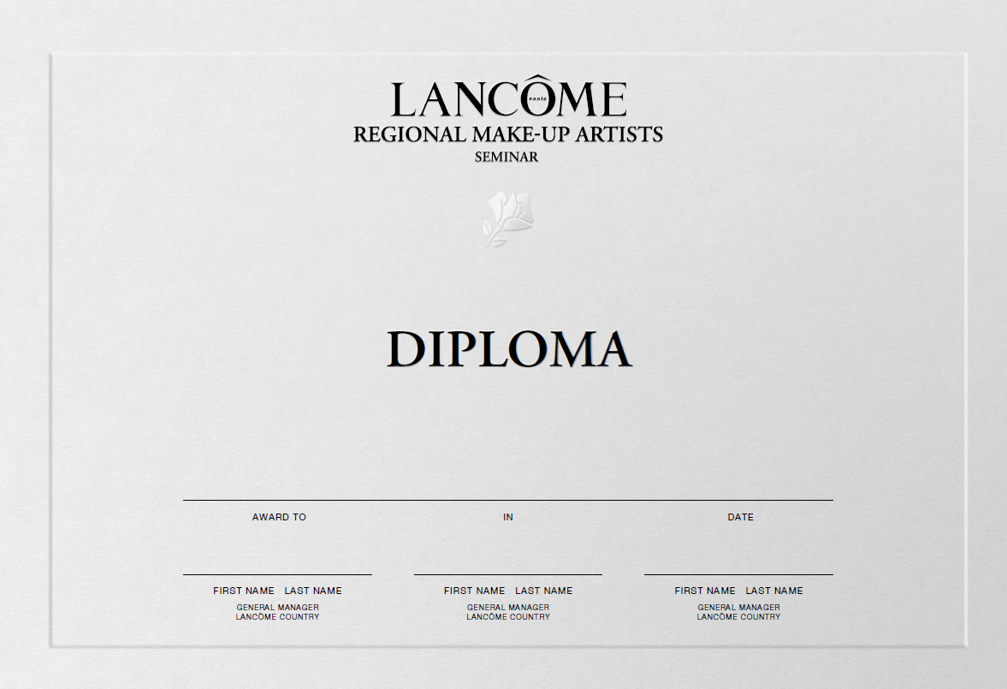

MAKE UP LEARNING TRACKS
ROLES & EXPERTISES
TITLE
SKILLS
DMI TRAINING & SEMINARS
TRAINING TOOLS
COST
TIMING
DMI AWARDS
Communication
Digital
Transmission
Creativity
Trends, Brand, Product, #messwithlancome, Beauty tech
master
#messwithlancome/ Trends/P.R
Beautytech/ Messterclass/ VIP Podium
Advocacy
3 DAYS
1800 Euros
(not including hotel & flight)
NATIONAL
MAKE-UP
ARTIST
MU TRAINERS
Target 30 NMA trained by
DMI & D.A
Annual NMA seminar 0+0 & MU Trainers
R&E for Trainers
Communication
Digital
Podiumers & Business
Brand,Product, #messwithlancome,
Beauty tech
specialist
#messwithlancome/ Trends
Beautytech/ Messterclass/ Podium
Lancôme Services 15’ & 45’
Demi-démo
Advocacy
2 DAYS
1650 Euros
(including hotel & no including flight)
Target 10% Senior
Senior MU Artists trained by NMA/local & DMI
4 steps training plan
Regional Make-up Seminars
MAKE-UP
ARTIST
advanced
#messwithlancôme adapted BAs/ Trends
Beautytech
Lancôme Make-up Services 2’ & 15’
Demi-démo
Advocacy
2 DAYS
LOCAL
MAKE-UP
EXPERTS
Digital
Podiumers & Business
Brand, Product,
#messwithlancome
Beauty tech
Target 6%
Make-up Experts trained by NMA locally
4 step Training Plan:
Opportunity to create Senior
Make-Up Artist
Local seminars
CERTIFICATE
PRODUCT FUNDAMENTALS
#messwithlancôme adapted BA’s/ Trends
Beautytech
Lancôme Services 2’ & 15’
Demi-demo
Advocacy
2 DAYS
LOCAL
Local Awards
inspire by DMI
BAs
All Lancôme Beauty Advisors 10K
4 steps Training plan + Local action plan
Launches & Pillars (2 min Beauty Icons)

Slide 16
FRAGRANCE LEARNING TRACKS
ROLES & EXPERTISES
TITLE
SKILLS
DMI TRAINING & SEMINARS
TRAINING TOOLS
COST
TIMING
DMI AWARDS
A recognized fragrance ambassador
Expert of the Absolue les Parfum collection
Master advanced cross/link selling
Be able to coach and train
specialist
Absolue les parfums seminar
1 day presential (DMI invited) on demand – Travel and hotel
Absolue les parfums expert
Lancôme fragrance expert
FRAGRANCE
TRAINER
advanced
Lancôme fragrance essentials
Lancome fragrance storytelling
Lancome the rose
Lancome deep dive pillars
1 day presential on demand
BA FRAGRANCE
EXPERT
Perform advanced story telling
Know at least iconic fragrances composition
Able to present the main portfolio
Fragrance Essentials
Fragrance storytelling module
The Lancome Rose
CERTIFICATE
Know Lancôme fragrance philosophy
Know Lancôme best-seller fragrances
Able to identify customer needs
Able to perform Fragrances Customer Path
Able to answer objections
NEWCOMERS SEMINAR
Lancôme welcome course
DIGITAL or local activation
Local Awards
inspire by DMI
BA
All Lancôme Beauty Advisors 10K
Launches & Pillars (2 min Beauty Icons)

